Slide 1

Java Features

Slide 2
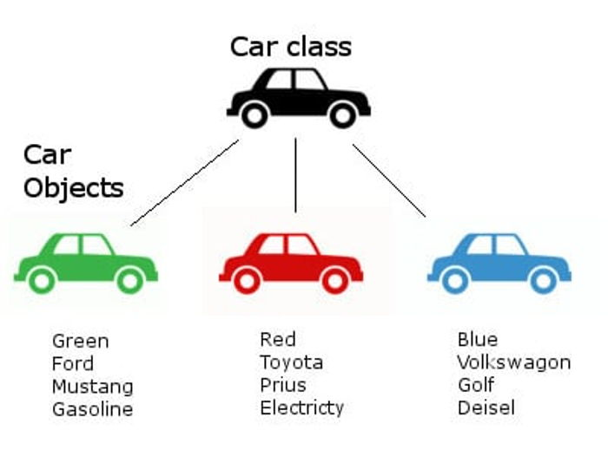
Object Oriented Programming (OOP)
Object oriented technique is modeled on the real world that we see all around.
A car represents a "class" meaning , it represent certain basic attributes and behavior.
Object Oriented Programming (OOP)

Slide 3
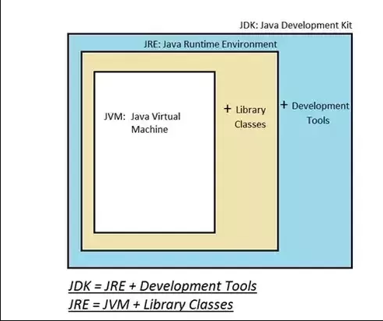
JVM vs JRE vs JDK
The Java virtual machine (JVM) is actually responsible for executing the compiled bytecode of a java program.
Java installation comes in two flavors, a Java Runtime Environment (JRE) & Java Development Kit (JDK).
The JRE is purely only for running the compiled java program and does not contains tools to compile a java program.
On the other hand JDK is a complete package with both compilation as well execution facility.
However from Java 11 onwards the JRE or Server JRE is no longer offered. Only the JDK is offered, which includes JRE.

Slide 4
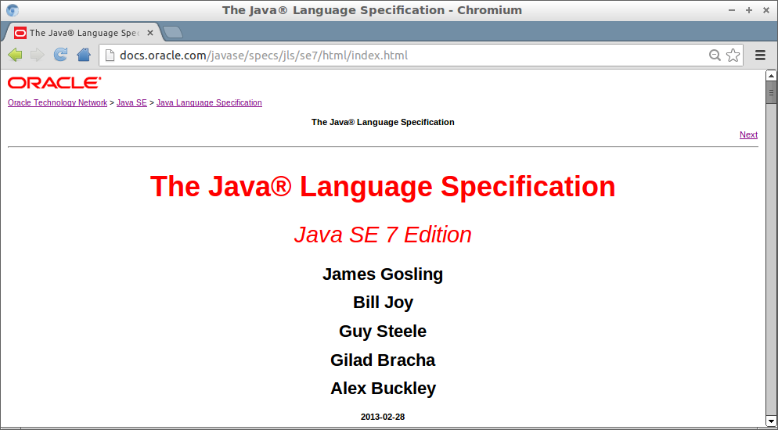
Java Specification
Java language specification is a document that defines essential parts of a java language implementation.
It defines all necessary grammar rules and syntax for java language.
Similarly there is a java virtual machine specification and JVM is a reference implementation for it also commonly referred to as Hotspot VM.

Slide 5
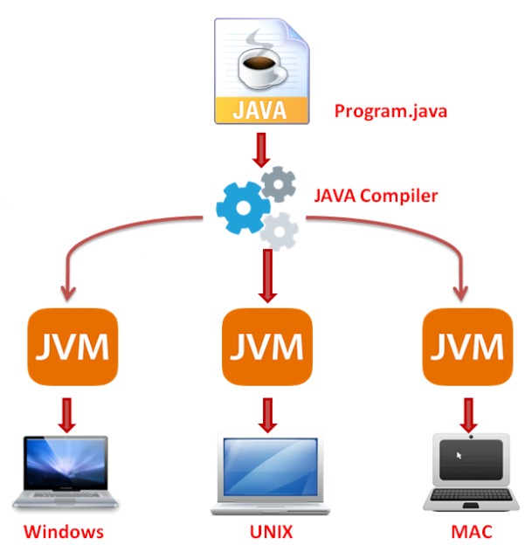
Write once, Run Anywhere
Java programing language is archtechturally neutral. This means that a java program once compiled can be taken and run on any system/processor which has the corresponding JVM installed.
This is referred to as write once and run anywhere feature of java.
This is made possible as a result of the bytecode that Java generates at the end of compilation process.
Java also provides JVM implementations for major OS/processor types like windows,unix,mac etc.
The bytecode then gets executed on platform specific JVM.

Slide 6

Memory Management
Java provides in build memory management facility.
Java’s memory manager is referred to as garbage collector.
A java programmer does not need to take care of creating and destroying memory.
Earlier in languages like C , it was required to first reserve memory and after usage it had to destroyed.
In java , a programmer can just signal the garbage collector to run but it is the sole responsibility of java runtime system to run garbage collector.

Slide 7

Questions ??

